Slide 1
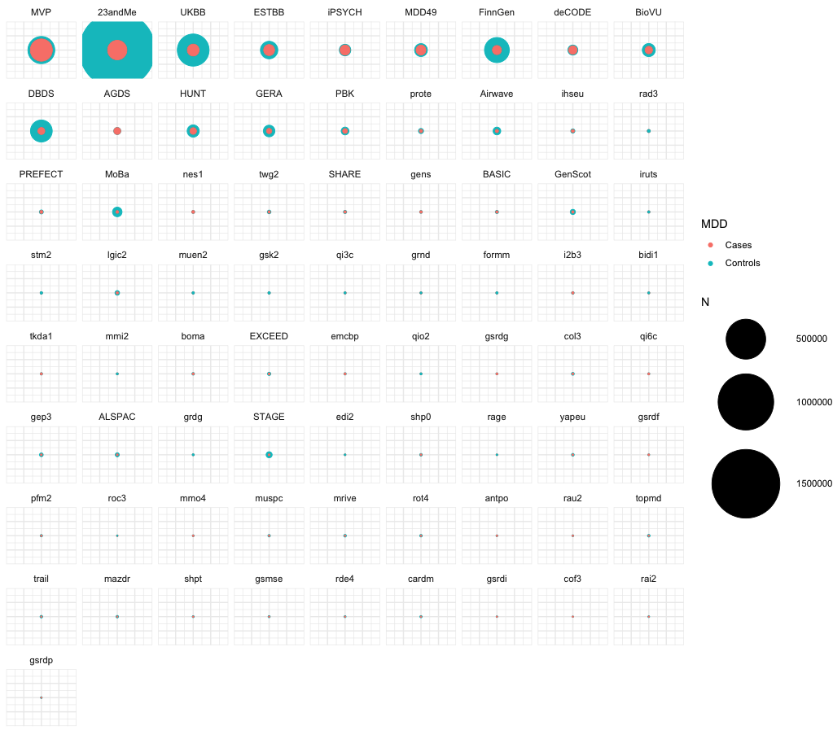
MDD3 Discovery
Group = EUR
Cohorts = 77
Cases = 524,857 Controls = 3,059,006
N_{Eff_half} = 776,935
Cases
Controls
MDD3 Prediction
Group | Cas. | Con. | Studies
SAS | 3,039 | 12,274 | 3
EAS | 11,427 | 78,432 | 4
AFR | 2,032 | 7,984 | 3
HIS | 2,555 | 38,059 | 3
Analysts: Swapnil Awasthi, Mark Adams, Kartik Chundru

Slide 2
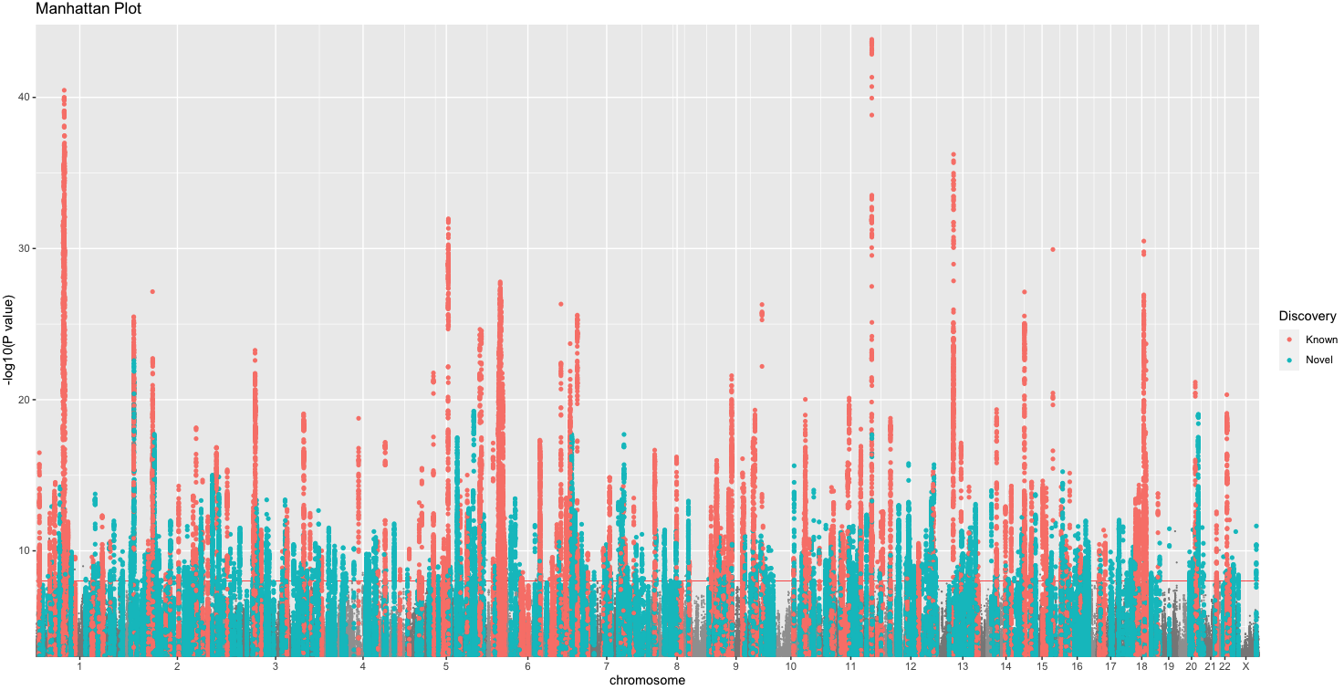
Cases = 0.5M, Controls = 3M
555 independent SNPs in 503 regions
EUR Ancestries Discovery: Known Novel
Analysts: Swapnil Awasthi, Mark Adams

Slide 3
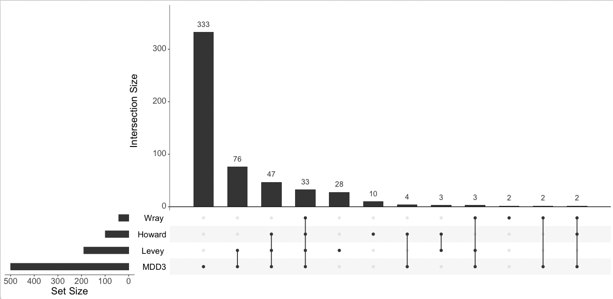
Comparison to previous findings
Overlap of regions containing GW-sig SNPs
Analysts: Mark Adams

Slide 4
LDSC
Input: N = Neff, sample prev. = 50%, pop prev. = 15%
LDSC h2 = 0.0625 (0.002)
LDSC rg
Category | Phenotype | rg
Psychiatric | Depressive symptoms | 0.86
Personality | Neuroticism | 0.68
Psychiatric | Bipolar disorder | 0.42
Psychiatric | Schizophrenia | 0.38
Trauma | Trauma exposure in MDD-neg | 0.40
Behaviour | Smoking | 0.30
Anthropometric | Waist-hip ratio | 0.17
Education | Years of schooling | -0.16
Lipid | Triglycerides | 0.14
Life history | Age at menarche | -0.13
Immune system | CRP level | 0.11
Analysts: Mark Adams

Slide 5
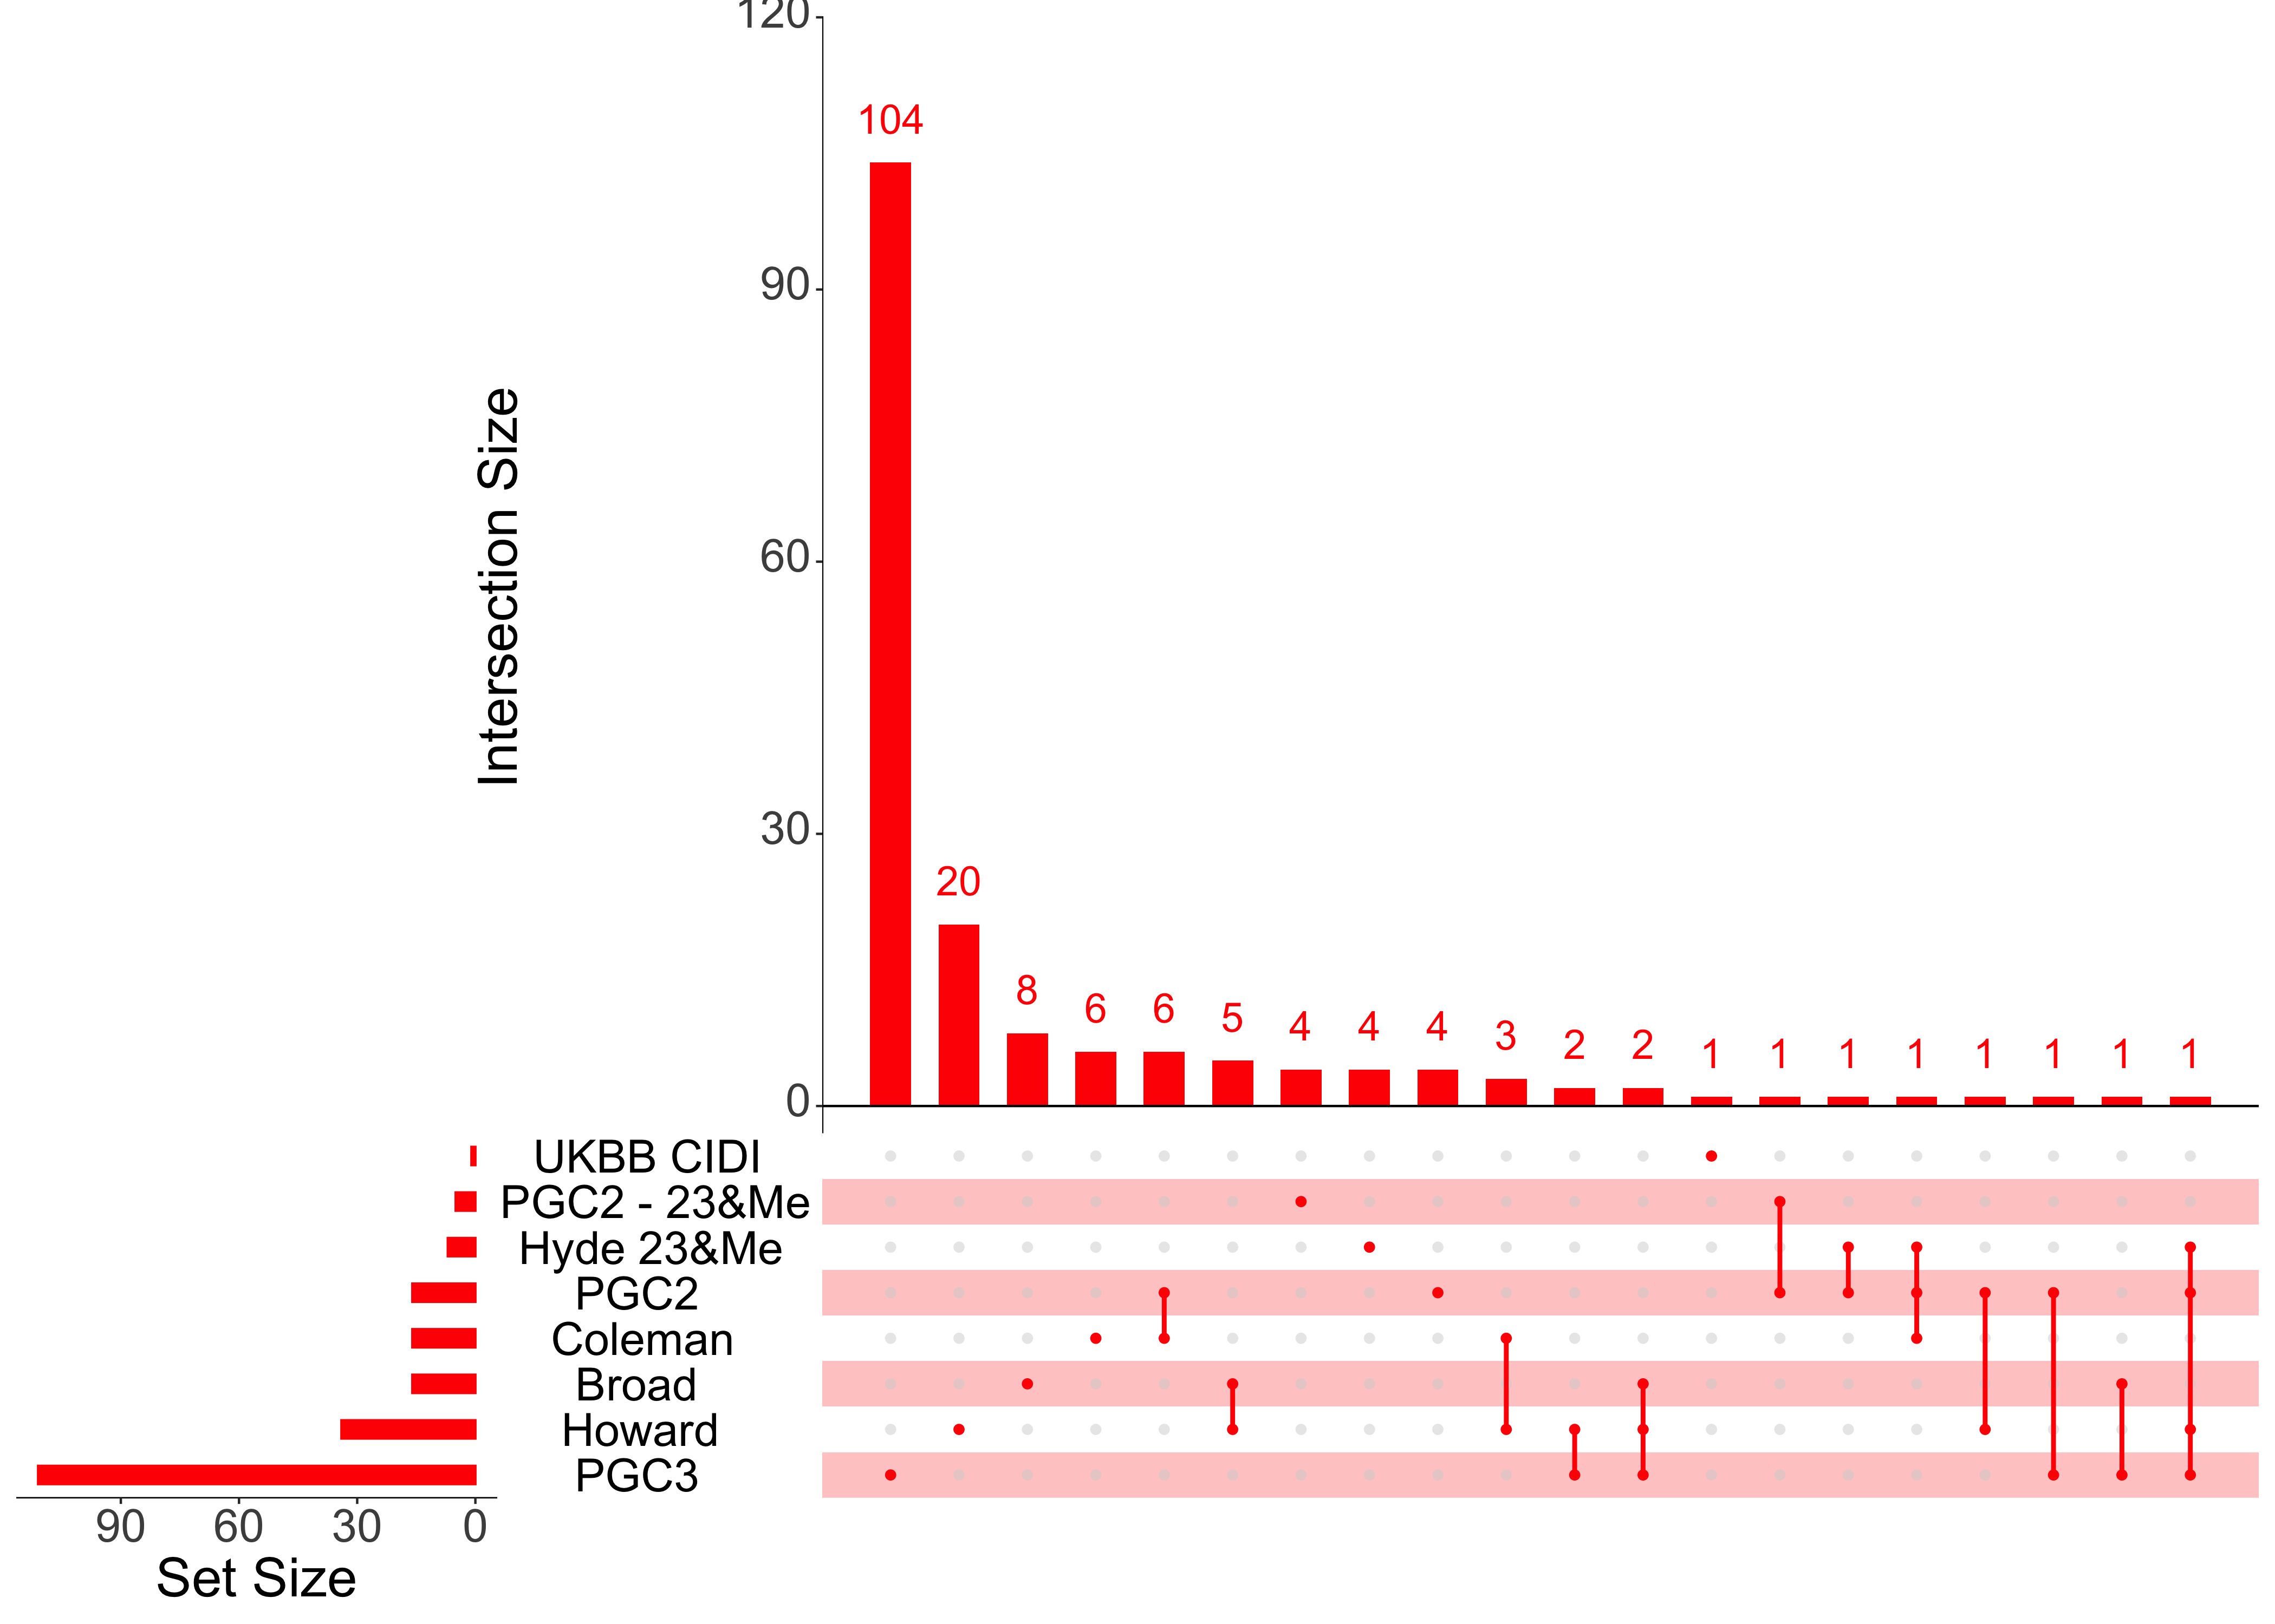
Fine-mapping
Study | GWS Loci | PIP95 | PIP50
Hyde (23&Me) | 15 | 0 (0) | 7 (7)
MDD2 - 23&Me | 2 | 0 (0) | 5 (4)
MDD2 | 44 | 0 (0) | 16 (16)
UKBB Broad | 14 | 1 (3) | 16 (10)
UKBB CIDI | 0 | 0 (0) | 1 (5)
Howard | 102 | 1 (2) | 34 (23)
Coleman (MDD2 + CIDI) | 63 | 0 (2) | 16 (19)
MDD3 * | 400+ | 9 (7) | 111 (111)
Includes variants near KIF1A, VRK2, ESR1, FES/FURIN, TSHZ3
MDD3
Analysts: Jonathan Coleman
Notes:
KIF1A: kinesin. axonal microtubule transport
VRK2: vaccinia-related kinase (VRK) family of serine/threonine protein kinases. apoptosis tumor growth
ESR1: estrogen receptor
FES: tyrosine-specific protein kinase activity and that activity is required for maintenance of cellular transformation, cytokine receptor signaling.
FURIN: paired basic amino acid cleaving enzyme. ”the spike protein of SARS-CoV-2 is thought to be uniquely cleaved by this protease”
TSHZ3: teashirt zinc finger homeobox. smooth muscle cell differentiation

Slide 6
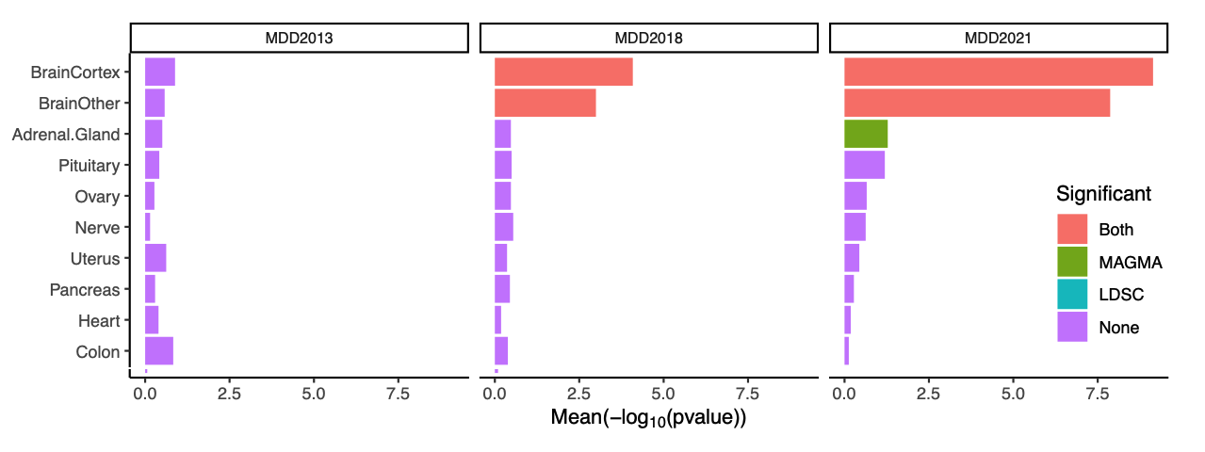
Tissues/cell types implicated
Enrichment analysis using stratified LDSC and MAGMA (GTEx version 8)
Analysts: Shuyang Yao, Lu Yi

Slide 7
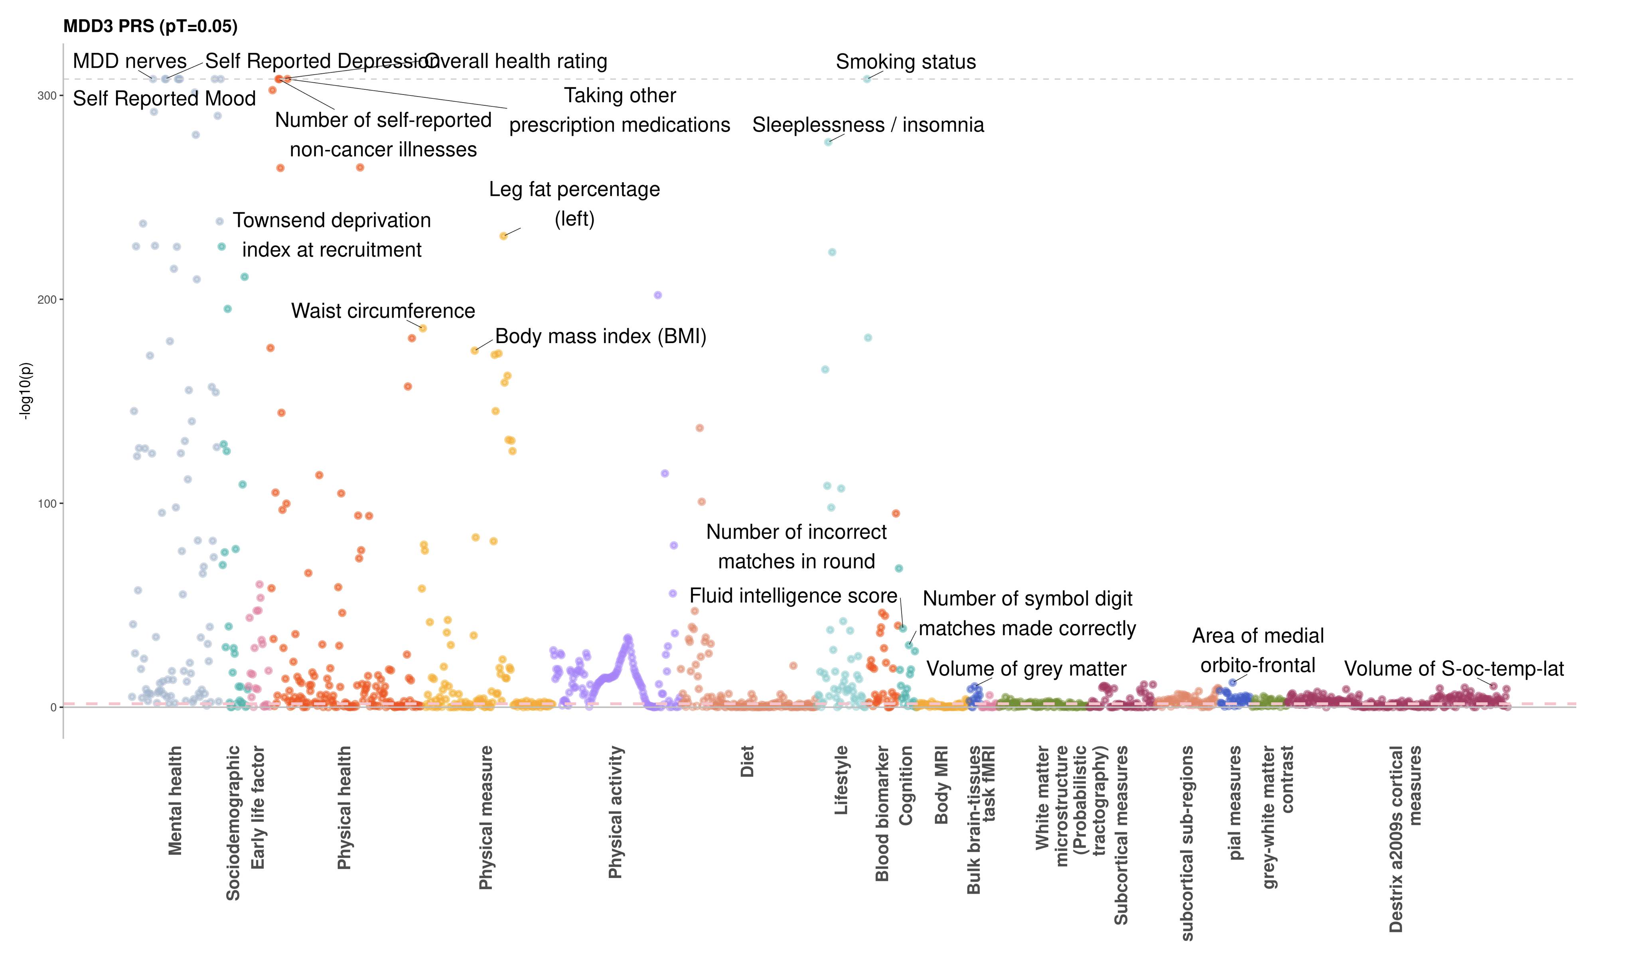
PheWAS in UKBB
Analysts: Xueyi Shen, Karmel Choi

Slide 8

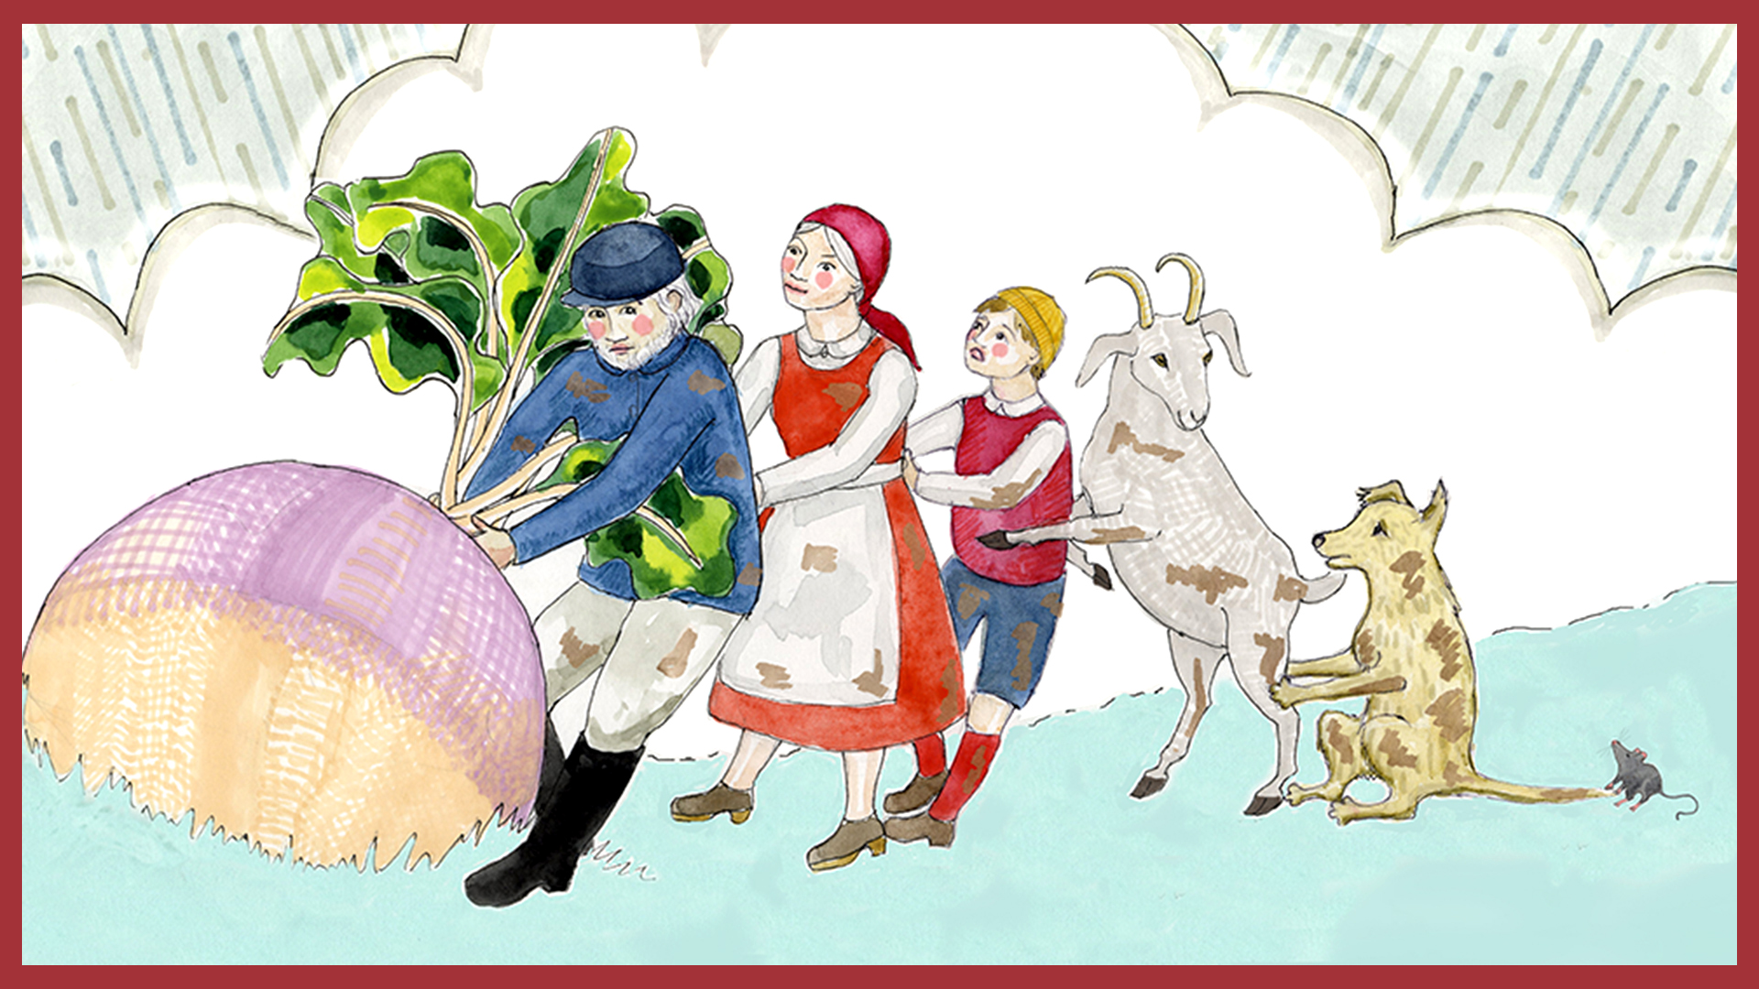
MDD3
Analytic Team: Mark Adams, Swapnil Awasthi, Fabian Streit, Oliver Pain, Jonathan Coleman, Xueyi Shen, Xiangrui Meng, Alex Kwong, Shuyang Yao, Jackson Thorp, Bochao Lin, Gita Pathak, Abigail ter Kuile, Alish Palmos, Qinqin Huang, Kartik Chundru, Karmel Choi, Zac Gerring, David Howard, Na Cai, Lu Yi, Hilary Martin, Eva Schulte
Analytic Directors: Eske Derks, Karoline Kuchenbäcker, Patrick Sullivan, Naomi Wray, Stephan Ripke
Workgroup Chairs: Cathryn Lewis, Andrew McIntosh
Study PIs: Albertine J. Oldehinkel, Alessandro Serretti, Alkistis Skalkidou, Anders Børglum, Arianna Di Florio, Bendik S Winsvold, Bernhard Baune, Bernice Porjesz, Bertram Muller-Myhsok, Brenda Penninx, Byron Creese, Catharina A. Hartman, Christel Middeldorp, Christian Rück, Colin Palmer, Dan Stein, Daniel Mueller, Danielle Posthuma, Dorret Boomsma, Doug Levinson, Enrico Domenici, Frances Rice, Gerome Breen, Giovanni Salum, Hans Grabe, Henning Tiemeier, Henriette Nørmølle Buttenschøn, Hermine Maes, Hilary Coon, Jaakko Kaprio, Jens Robert Wendland, Joel Gelernter, Jurjen Luykx, Kenneth Kendler, Klaus Berger, Klaus Lieb, Lea Davis, Lili Milani, Marcella Rietschel, Margarita Rivera, Martin Preisig, Martin Tobin, Mikael Landén, Monica Uddin, Nicholas Timpson, Nick Martin, Ole Andreassen, Ole Mors, Patricia Chou, Patrik Magnusson, Paul Elliot, Po-Hsiu Kuo, Qingqin Li, Roland Ricken, Roy Perlis, Rudolf Uher, Sara Paciga, Srijan Sen, Steve Hamilton, Susanne Lucae, Ted Reichborn-Kjennerud, Tilo Kircher, William Copeland, 23andMe Research Team
The PGC has received funding from the US National Institute of Mental Health (5 U01MH109528-04). Statistical analyses were carried out on the Genetic Cluster Computer (http://www.geneticcluster.org) hosted by SURFsara and financially supported by the Netherlands Scientific Organization (NWO 480-05-003) along with a supplement from the Dutch Brain Foundation and the VU University Amsterdam.

